Slide 1
Spatial Localization and Detection
Ric Poirson
Slide Credits: Justin Johnson, Andrej Karpathy, Fei-Fei Li
Fei-Fei Li & Andrej Karpathy & Justin Johnson Lecture 8 - 1 Feb 2016
Lecture 8 -
1

Slide 2
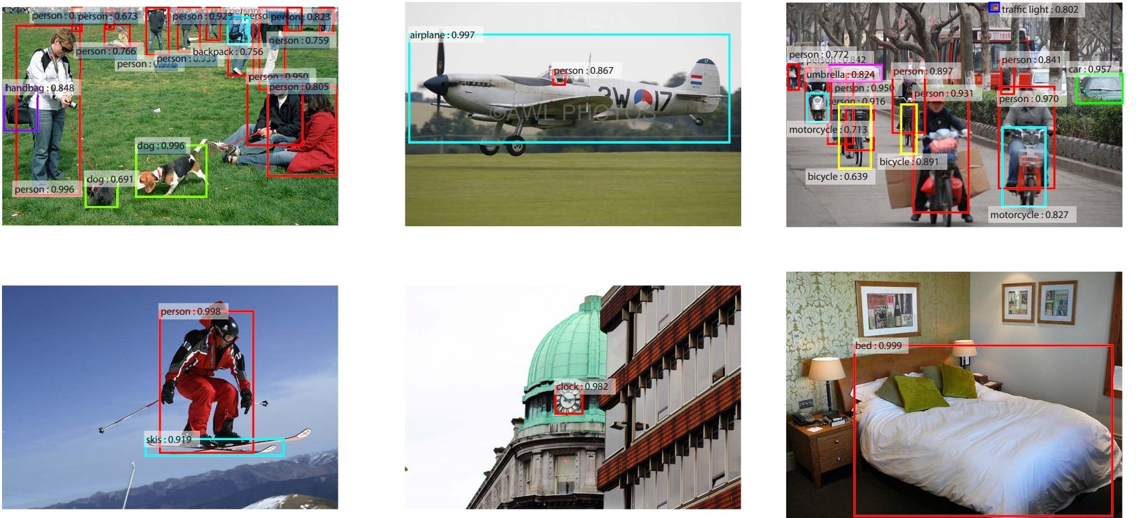
Localization and Detection
Results from Faster R-CNN, Ren et al 2015
Fei-Fei Li & Andrej Karpathy & Justin Johnson Lecture 8 - 1 Feb 2016
Lecture 8 -
7

Slide 3
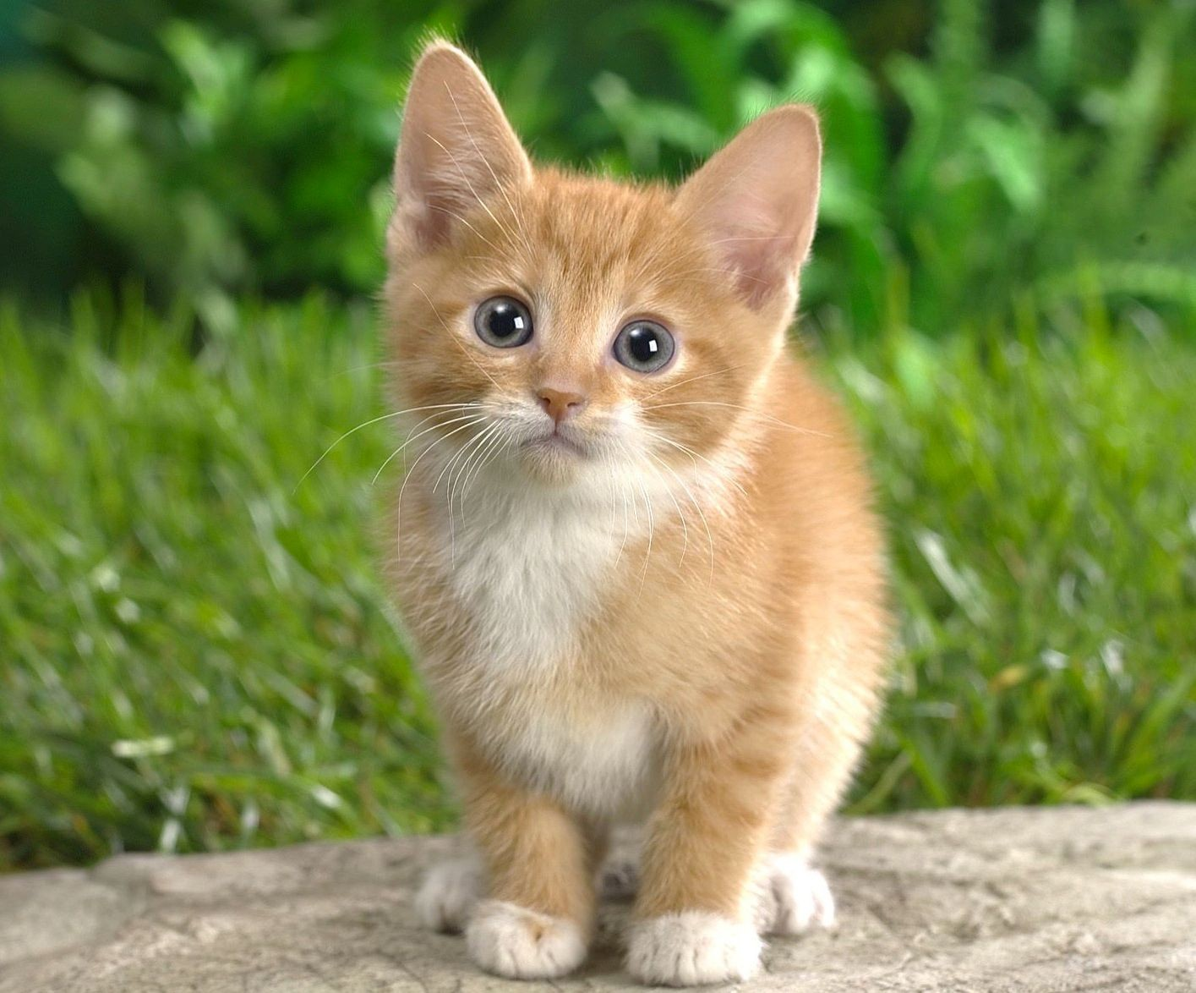

Computer Vision Tasks
Classification
+ Localization
Instance Segmentation
Classification
Object Detection
CAT
CAT
CAT, DOG, DUCK
CAT, DOG, DUCK
Single object
Multiple objects
Fei-Fei Li & Andrej Karpathy & Justin Johnson Lecture 8 - 1 Feb 2016
Lecture 8 -
8

Slide 4


Computer Vision Tasks
Classification
+ Localization
Instance Segmentation
Classification
Object Detection
Fei-Fei Li & Andrej Karpathy & Justin Johnson Lecture 8 - 1 Feb 2016
Lecture 8 -
9

Slide 5
Classification + Localization: Task
Classification: C classes
Input: Image
Output: Class label
Evaluation metric: Accuracy
CAT
Localization:
Input: Image
Output: Box in the image (x, y, w, h)
Evaluation metric: Intersection over Union
(x, y, w, h)
Classification + Localization: Do both
Fei-Fei Li & Andrej Karpathy & Justin Johnson Lecture 8 - 1 Feb 2016
Lecture 8 - 10

Slide 6
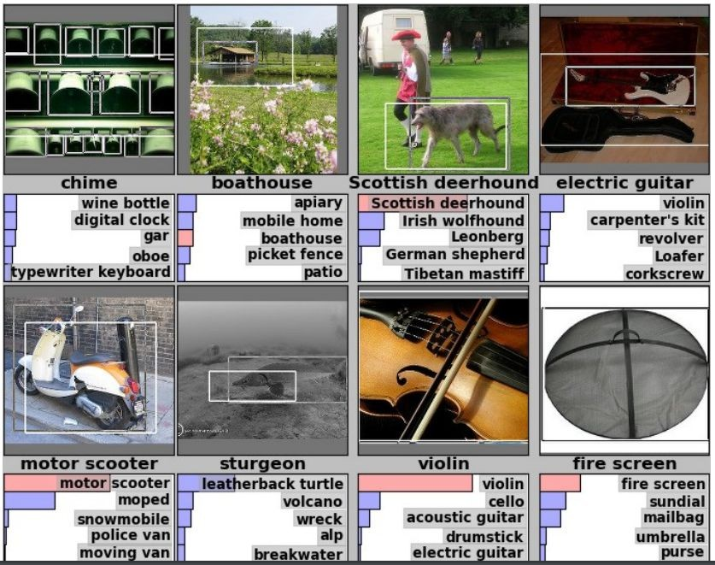
Classification + Localization: ImageNet
1000 classes (same as classification)
Each image has 1 class, at least one bounding box
~800 training images per class
Algorithm produces 5 (class, box) guesses
Example is correct if at least one one guess has correct class AND bounding box at least 0.5 intersection over union (IoU)
Krizhevsky et. al. 2012
Fei-Fei Li & Andrej Karpathy & Justin Johnson Lecture 8 - 1 Feb 2016
Lecture 8 - 11

Slide 7
Idea #1: Localization as Regression
Input: image
Neural Net
Output:
Box coordinates (4 numbers)
Loss: L2 distance
Correct output: box coordinates (4 numbers)
Only one object, simpler than detection
Fei-Fei Li & Andrej Karpathy & Justin Johnson Lecture 8 - 1 Feb 2016
Lecture 8 - 12

Slide 8
Simple Recipe for Classification + Localization
Step 1: Train (or download) a classification model (AlexNet, VGG, GoogLeNet)
Convolution and Pooling
Fully-connected layers
Softmax loss
Final conv feature map
Class scores
Image
Fei-Fei Li & Andrej Karpathy & Justin Johnson Lecture 8 - 1 Feb 2016
Lecture 8 - 13

Slide 9
Simple Recipe for Classification + Localization
Step 2: Attach new fully-connected “regression head” to the network
Fully-connected layers
“Classification head”
Convolution and Pooling
Class scores
Fully-connected layers
“Regression head”
Final conv feature map
Image
Box coordinates
Fei-Fei Li & Andrej Karpathy & Justin Johnson Lecture 8 - 1 Feb 2016
Lecture 8 - 14

Slide 10
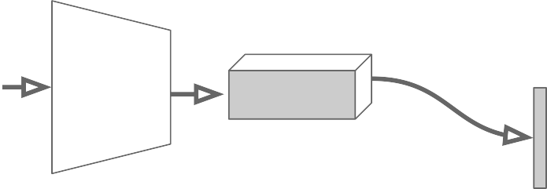
Simple Recipe for Classification + Localization
Step 3: Train the regression head only with SGD and L2 loss
Fully-connected layers
Convolution and Pooling
Class scores
Fully-connected layers
L2 loss
Final conv feature map
Image
Box coordinates
Fei-Fei Li & Andrej Karpathy & Justin Johnson Lecture 8 - 1 Feb 2016
Lecture 8 - 15

Slide 11
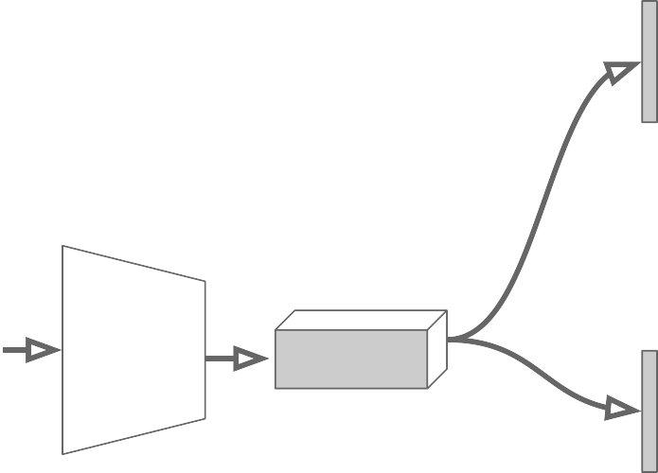
Simple Recipe for Classification + Localization
Step 4: At test time use both heads
Fully-connected layers
Convolution and Pooling
Class scores
Fully-connected layers
Final conv feature map
Image
Box coordinates
Fei-Fei Li & Andrej Karpathy & Justin Johnson Lecture 8 - 1 Feb 2016
Lecture 8 - 16

Slide 12
Per-class vs class agnostic regression
Assume classification over C classes:
Fully-connected layers
Classification head:
C numbers (one per class)
Convolution and Pooling
Class scores
Class agnostic:
4 numbers (one box)
Class specific:
C x 4 numbers (one box per class)
Fully-connected layers
Final conv feature map
Image
Box coordinates
Fei-Fei Li & Andrej Karpathy & Justin Johnson Lecture 8 - 1 Feb 2016
Lecture 8 - 17

Slide 13
Aside: Localizing multiple objects
Want to localize exactly K objects in each image
Fully-connected layers
(e.g. whole cat, cat head, cat left ear, cat right ear for K=4)
Convolution and Pooling
Class scores
Fully-connected layers
K x 4 numbers
(one box per object)
Final conv feature map
Image
Box coordinates
Fei-Fei Li & Andrej Karpathy & Justin Johnson Lecture 8 - 1 Feb 2016
Lecture 8 - 19

Slide 14
Idea #2: Sliding Window
Run classification + regression network at multiple locations on a high- resolution image
Convert fully-connected layers into convolutional layers for efficient computation
Combine classifier and
regressor predictions across all scales for final prediction
Fei-Fei Li & Andrej Karpathy & Justin Johnson Lecture 8 - 1 Feb 2016
Lecture 8 - 22

Slide 15
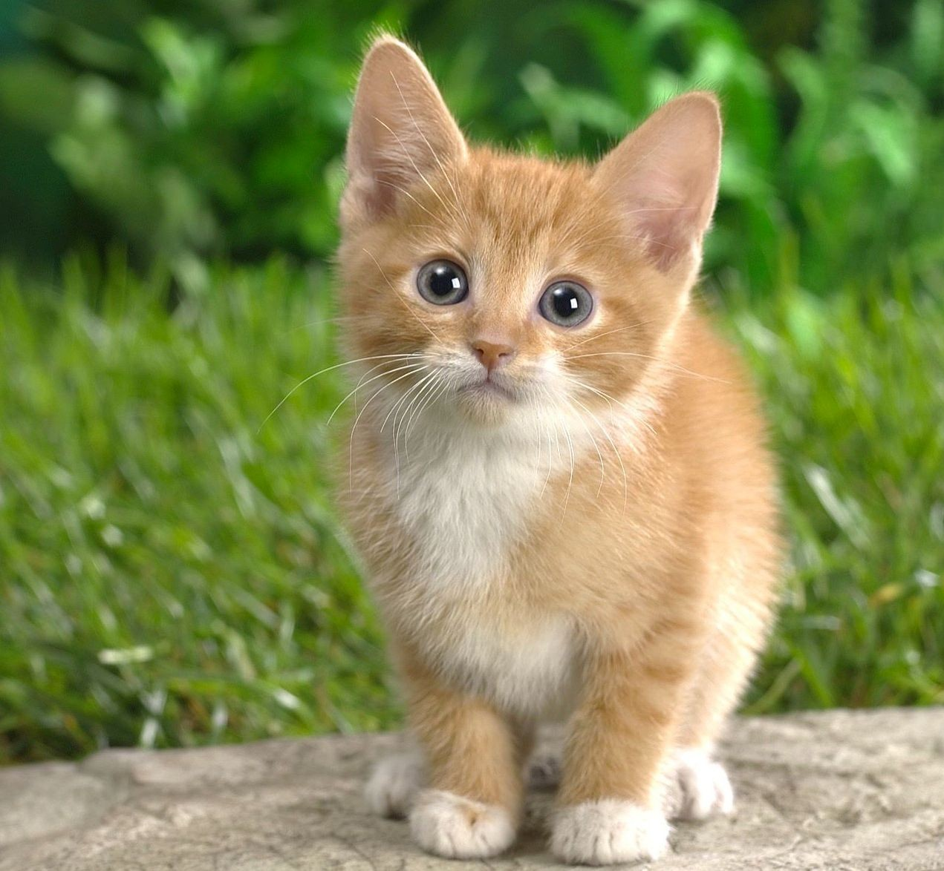
Sliding Window: Overfeat
4096
4096
Class scores: 1000
Winner of ILSVRC 2013 localization challenge
FC
FC
Convolution
+ pooling
Softmax loss
FC
FC
Feature map: 1024 x 5 x 5
FC
FC
Image:
3 x 221 x 221
Euclidean loss
1024
Boxes: 1000 x 4
Sermanet et al, “Integrated Recognition, Localization and Detection using Convolutional Networks”, ICLR 2014
4096
Fei-Fei Li & Andrej Karpathy & Justin Johnson Lecture 8 - 1 Feb 2016
Lecture 8 - 23

Slide 16
Sliding Window: Overfeat
Network input: 3 x 221 x 221
Larger image: 3 x 257 x 257
Fei-Fei Li & Andrej Karpathy & Justin Johnson Lecture 8 - 1 Feb 2016
Lecture 8 - 24

Slide 17
Sliding Window: Overfeat
0.5
Network input: 3 x 221 x 221
Larger image: 3 x 257 x 257
Classification scores: P(cat)
Fei-Fei Li & Andrej Karpathy & Justin Johnson Lecture 8 - 1 Feb 2016
Lecture 8 - 25

Slide 18
Sliding Window: Overfeat
0.5 | 0.75
Network input: 3 x 221 x 221
Larger image: 3 x 257 x 257
Classification scores: P(cat)
Fei-Fei Li & Andrej Karpathy & Justin Johnson Lecture 8 - 1 Feb 2016
Lecture 8 - 26

Slide 19
Sliding Window: Overfeat
0.5 | 0.75
0.6
Network input: 3 x 221 x 221
Larger image: 3 x 257 x 257
Classification scores: P(cat)
Fei-Fei Li & Andrej Karpathy & Justin Johnson Lecture 8 - 1 Feb 2016
Lecture 8 - 27

Slide 20
Sliding Window: Overfeat
0.5 | 0.75
0.6 | 0.8
Network input: 3 x 221 x 221
Larger image: 3 x 257 x 257
Classification scores: P(cat)
Fei-Fei Li & Andrej Karpathy & Justin Johnson Lecture 8 - 1 Feb 2016
Lecture 8 - 28

Slide 21
Sliding Window: Overfeat
0.5 | 0.75
0.6 | 0.8
Network input: 3 x 221 x 221
Larger image: 3 x 257 x 257
Classification scores: P(cat)
Fei-Fei Li & Andrej Karpathy & Justin Johnson Lecture 8 - 1 Feb 2016
Lecture 8 - 29

Slide 22
Sliding Window: Overfeat
Greedily merge boxes and scores (details in paper)
0.8
Network input: 3 x 221 x 221
Larger image: 3 x 257 x 257
Classification score: P (cat)
Fei-Fei Li & Andrej Karpathy & Justin Johnson Lecture 8 - 1 Feb 2016
Lecture 8 - 30

Slide 23
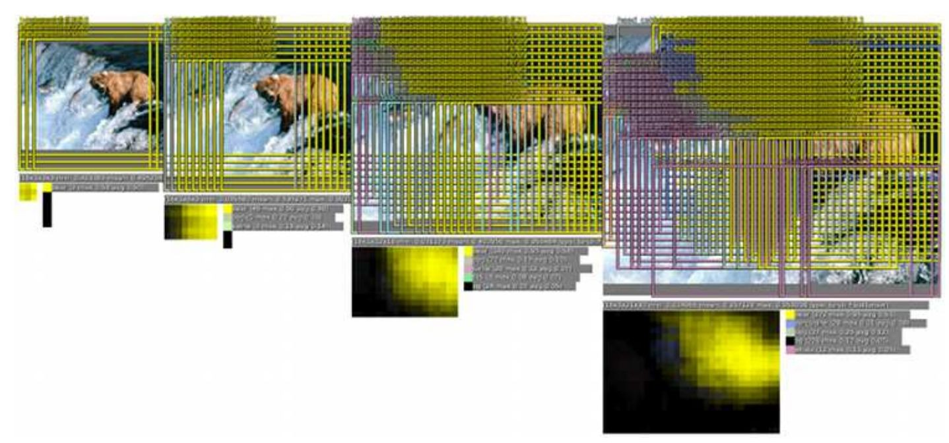
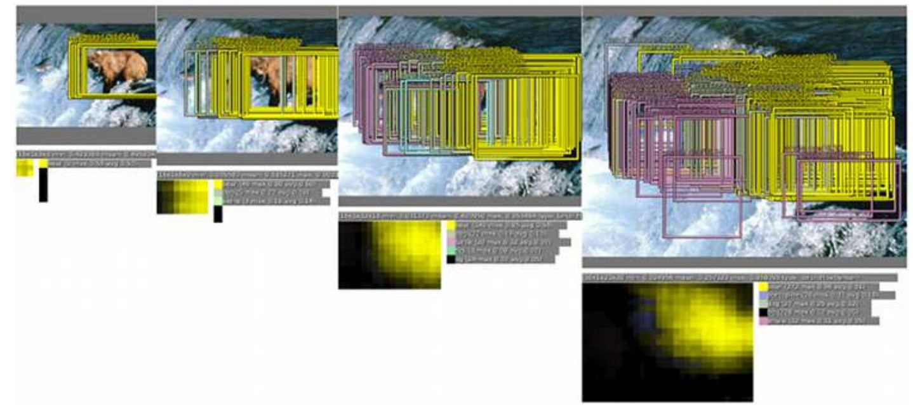
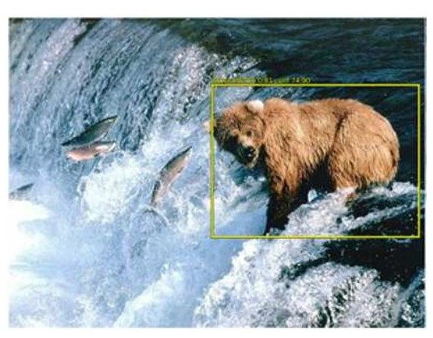
Sliding Window: Overfeat
In practice use many sliding window locations and multiple scales
Window positions + score maps
Box regression outputs
Final Predictions
Sermanet et al, “Integrated Recognition, Localization and Detection using Convolutional Networks”, ICLR 2014
Fei-Fei Li & Andrej Karpathy & Justin Johnson Lecture 8 - 1 Feb 2016
Lecture 8 - 31

Slide 24
Efficient Sliding Window: Overfeat
4096 4096
Class scores: 1000
FC
FC
Convolution
+ pooling
FC
FC
Feature map: 1024 x 5 x 5
FC
FC
Image:
3 x 221 x 221
1024
Boxes: 1000 x 4
4096
Fei-Fei Li & Andrej Karpathy & Justin Johnson Lecture 8 - 1 Feb 2016
Lecture 8 - 32

Slide 25
Efficient Sliding Window: Overfeat
Efficient sliding window by converting fully- connected layers into convolutions
4096 x 1 x 1
Class scores: 1000 x 1 x 1
1024 x 1 x 1
Convolution
+ pooling
1 x 1 conv
1 x 1 conv
5 x 5 conv
5 x 5 conv
Feature map: 1024 x 5 x 5
1 x 1 conv
1 x 1 conv
Image:
3 x 221 x 221
4096 x 1 x 1
1024 x 1 x 1
Box coordinates: (4 x 1000) x 1 x 1
Fei-Fei Li & Andrej Karpathy & Justin Johnson Lecture 8 - 1 Feb 2016
Lecture 8 - 33

Slide 26
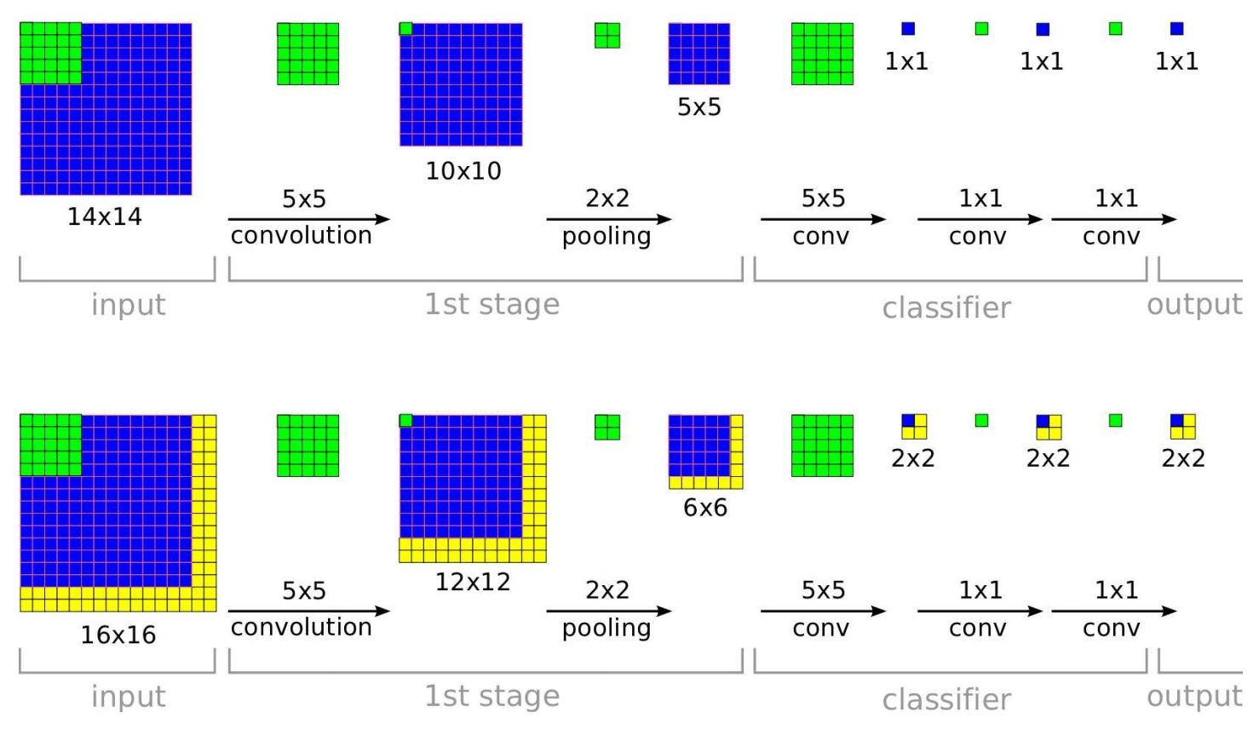
Efficient Sliding Window: Overfeat
Training time: Small image, 1 x 1 classifier output
Test time: Larger image, 2 x 2 classifier output, only extra compute at yellow regions
Sermanet et al, “Integrated Recognition, Localization and Detection using Convolutional Networks”, ICLR 2014
Fei-Fei Li & Andrej Karpathy & Justin Johnson Lecture 8 - 1 Feb 2016
Lecture 8 - 34

Slide 27
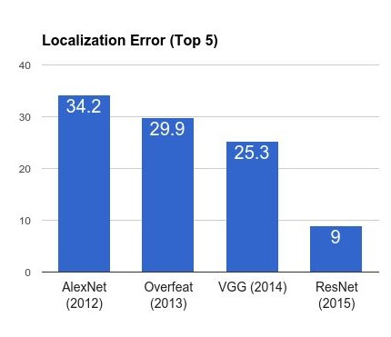
ImageNet Classification + Localization
AlexNet: Localization method not published
Overfeat: Multiscale convolutional regression with box merging
VGG: Same as Overfeat, but fewer scales and locations; simpler method, gains all due to deeper features
ResNet: Different localization method (RPN) and much deeper features
Fei-Fei Li & Andrej Karpathy & Justin Johnson Lecture 8 - 1 Feb 2016
Lecture 8 - 35

Slide 28
Computer Vision Tasks
Classification
+ Localization
Instance Segmentation
Classification
Object Detection
Fei-Fei Li & Andrej Karpathy & Justin Johnson Lecture 8 - 1 Feb 2016
Lecture 8 - 36

Slide 29
Computer Vision Tasks
Classification
+ Localization
Instance Segmentation
Classification
Object Detection
Fei-Fei Li & Andrej Karpathy & Justin Johnson Lecture 8 - 1 Feb 2016
Lecture 8 - 37

Slide 30
Detection as Regression?
DOG, (x, y, w, h)
CAT, (x, y, w, h)
CAT, (x, y, w, h)
DUCK (x, y, w, h)
= 16 numbers
Fei-Fei Li & Andrej Karpathy & Justin Johnson Lecture 8 - 1 Feb 2016
Lecture 8 - 38

Slide 31

Detection as Regression?
DOG, (x, y, w, h)
CAT, (x, y, w, h)
= 8 numbers
Fei-Fei Li & Andrej Karpathy & Justin Johnson Lecture 8 - 1 Feb 2016
Lecture 8 - 39

Slide 32
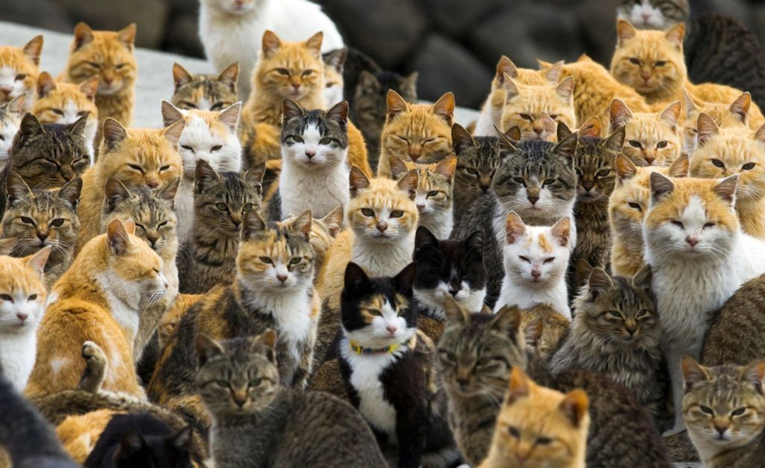
Detection as Regression?
CAT, (x, y, w, h)
CAT, (x, y, w, h)
….
CAT (x, y, w, h)
= many numbers
Need variable sized outputs
Fei-Fei Li & Andrej Karpathy & Justin Johnson Lecture 8 - 1 Feb 2016
Lecture 8 - 40

Slide 33
Detection as Classification
CAT? NO
DOG? NO
Fei-Fei Li & Andrej Karpathy & Justin Johnson Lecture 8 - 1 Feb 2016
Lecture 8 - 41

Slide 34
Detection as Classification
CAT? YES!
DOG? NO
Fei-Fei Li & Andrej Karpathy & Justin Johnson Lecture 8 - 1 Feb 2016
Lecture 8 - 42

Slide 35
Detection as Classification
CAT? NO
DOG? NO
Fei-Fei Li & Andrej Karpathy & Justin Johnson Lecture 8 - 1 Feb 2016
Lecture 8 - 43

Slide 36
Detection as Classification
Problem: Need to test many positions and scales, and use a computationally demanding classifier (CNN)
Solution: Only look at a tiny subset of possible positions
Fei-Fei Li & Andrej Karpathy & Justin Johnson Lecture 8 - 1 Feb 2016
Lecture 8 - 48

Slide 37
Region Proposals
Find “blobby” image regions that are likely to contain objects
“Class-agnostic” object detector
Look for “blob-like” regions
Fei-Fei Li & Andrej Karpathy & Justin Johnson Lecture 8 - 1 Feb 2016
Lecture 8 - 49

Slide 38
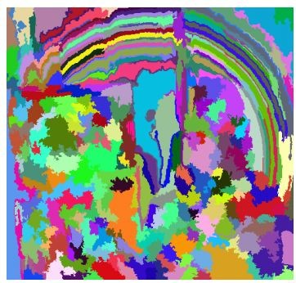
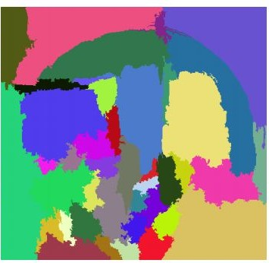
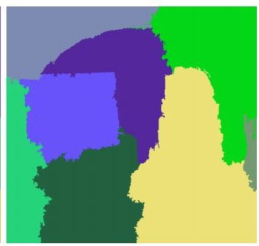
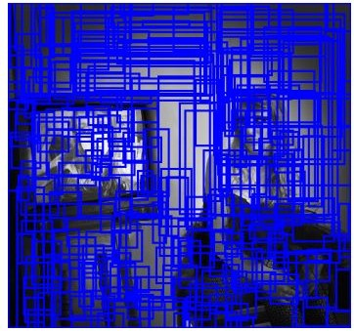
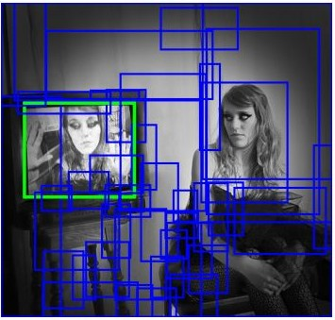
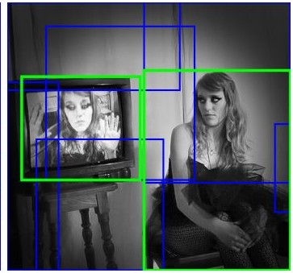
Region Proposals: Selective Search
Bottom-up segmentation, merging regions at multiple scales
Convert regions to boxes
Uijlings et al, “Selective Search for Object Recognition”, IJCV 2013
Fei-Fei Li & Andrej Karpathy & Justin Johnson Lecture 8 - 1 Feb 2016
Lecture 8 - 50

Slide 39
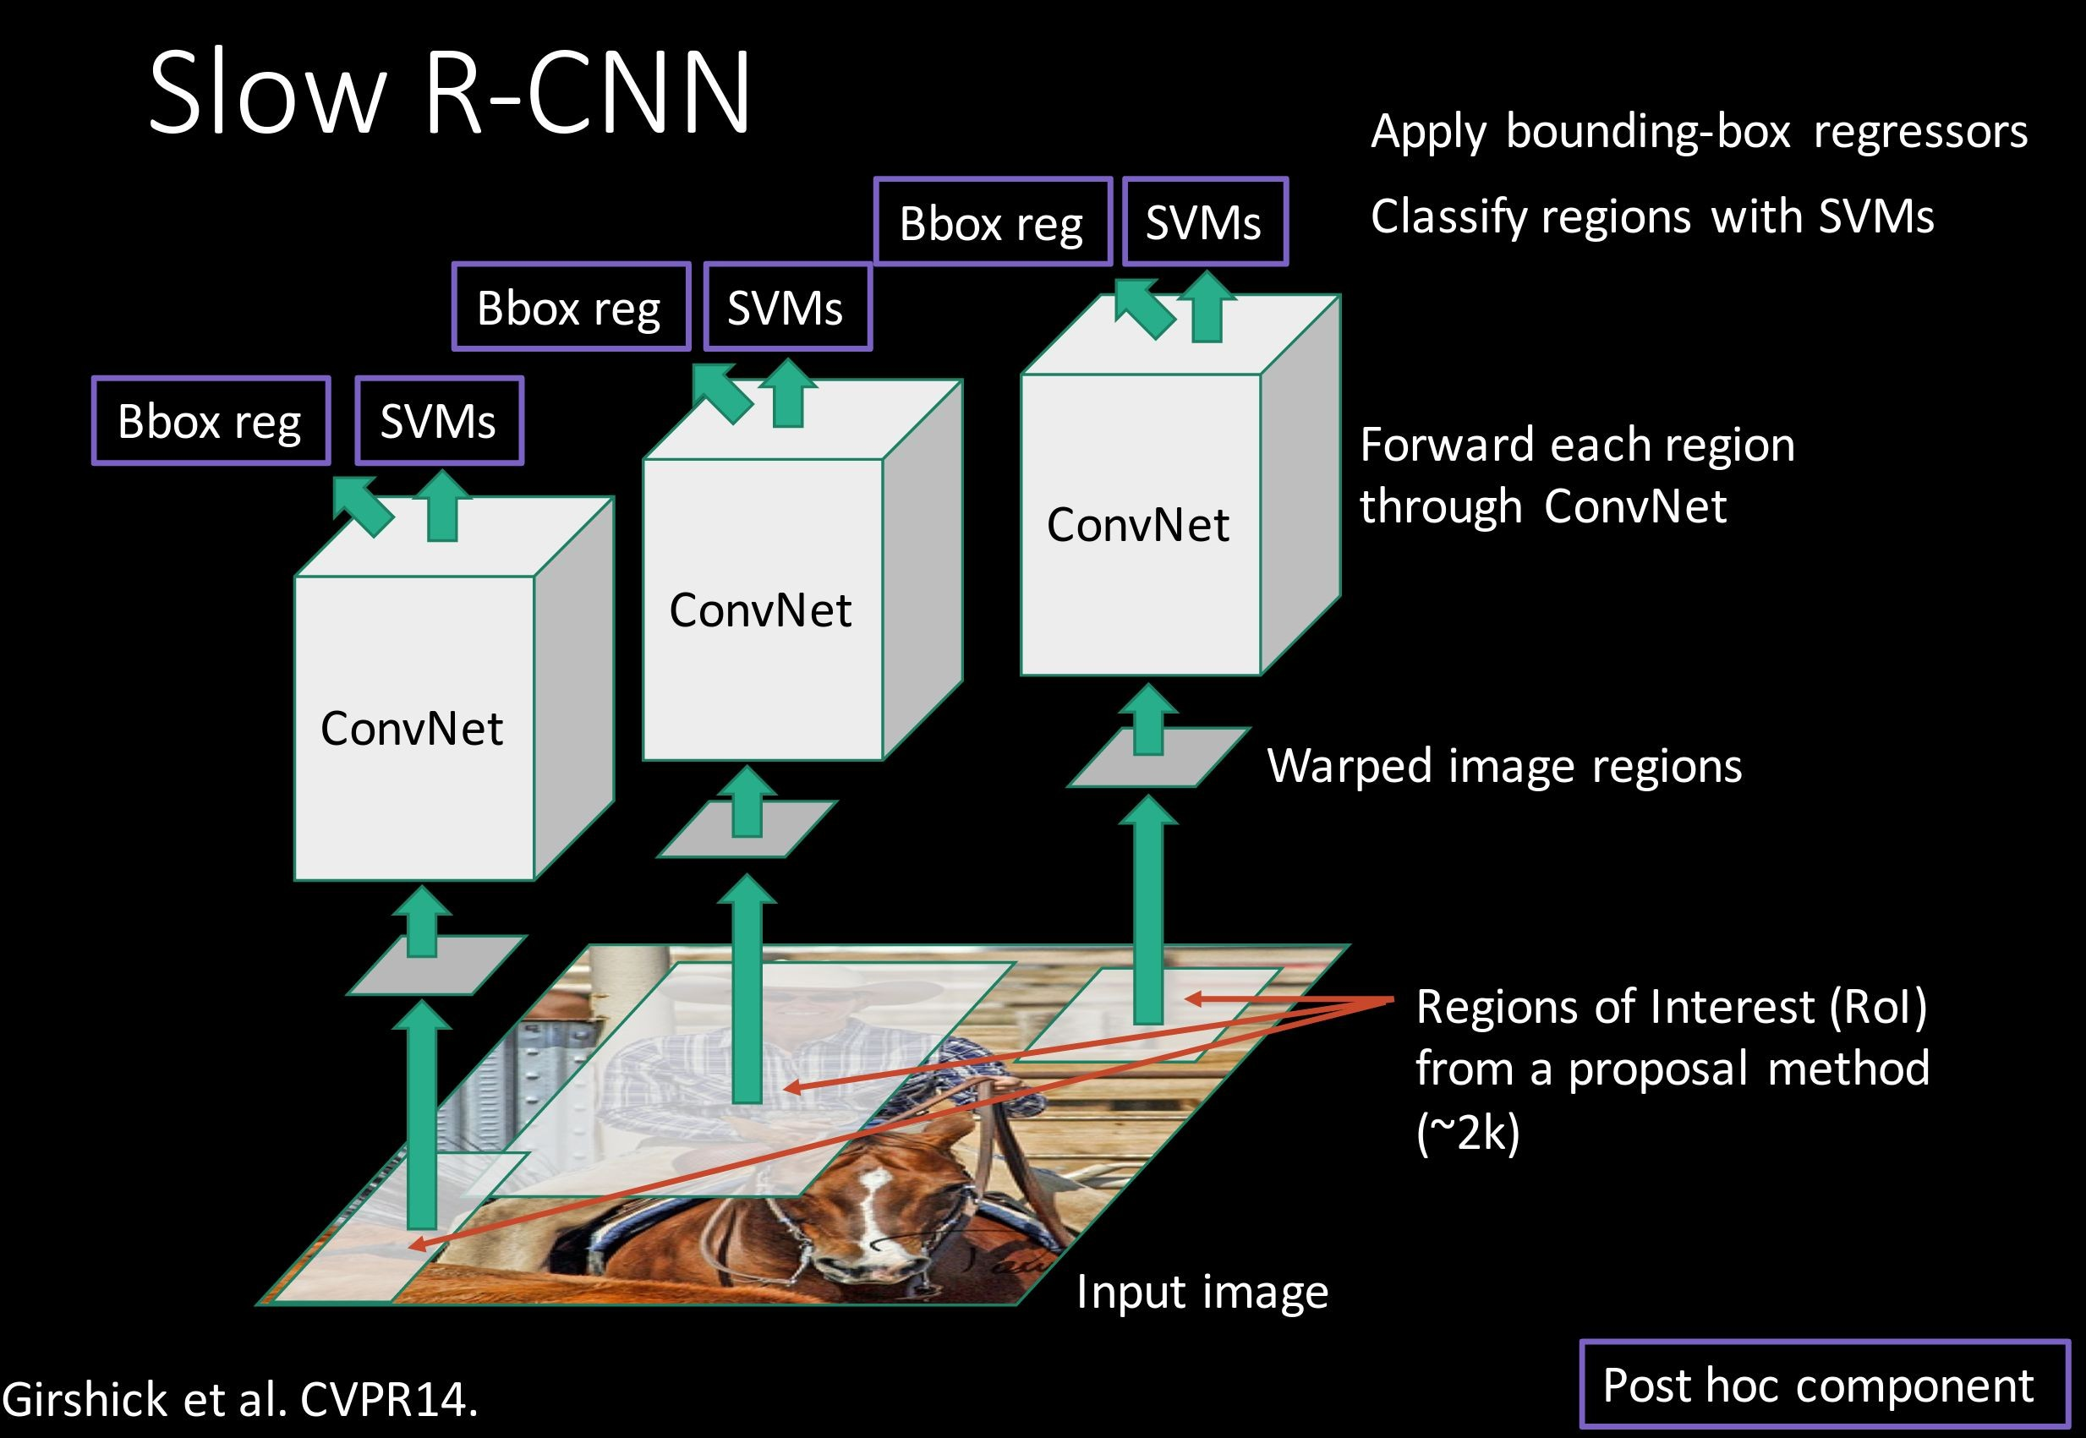
Putting it together: R-CNN
Girschick et al, “Rich feature hierarchies for accurate object detection and semantic segmentation”, CVPR 2014
Slide credit: Ross Girschick
Fei-Fei Li & Andrej Karpathy & Justin Johnson Lecture 8 - 1 Feb 2016
Lecture 8 - 53

Slide 40
R-CNN Training
Step 1: Train (or download) a classification model for ImageNet (AlexNet)
Convolution and Pooling
Fully-connected layers
Softmax loss
Final conv feature map
Class scores 1000 classes
Image
Fei-Fei Li & Andrej Karpathy & Justin Johnson Lecture 8 - 1 Feb 2016
Lecture 8 - 54

Slide 41
R-CNN Training
Step 2: Fine-tune model for detection
Instead of 1000 ImageNet classes, want 20 object classes + background
Throw away final fully-connected layer, reinitialize from scratch
Keep training model using positive / negative regions from detection images
Re-initialize this layer: was 4096 x 1000,
now will be 4096 x 21
Convolution and Pooling
Fully-connected layers
Softmax loss
Final conv feature map
Class scores: 21 classes
Image
Fei-Fei Li & Andrej Karpathy & Justin Johnson Lecture 8 - 1 Feb 2016
Lecture 8 - 55

Slide 42


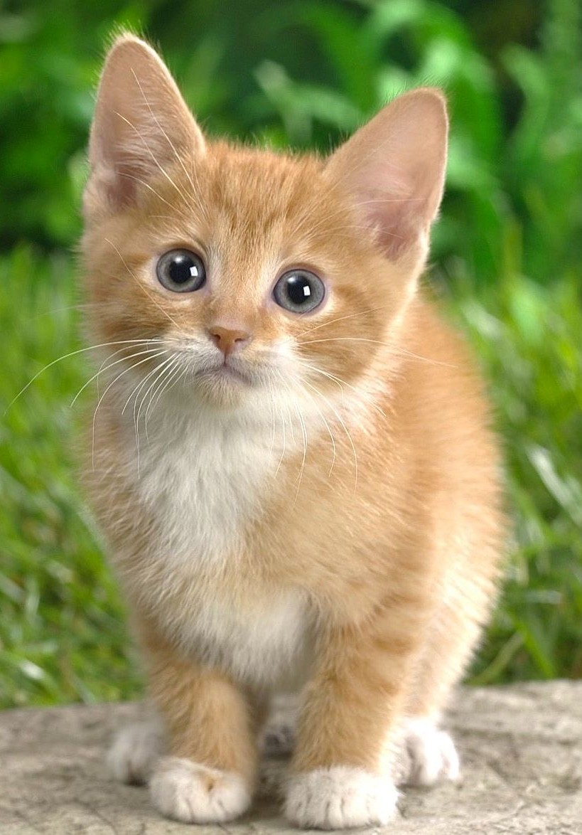
R-CNN Training
Step 3: Extract features
Extract region proposals for all images
For each region: warp to CNN input size, run forward through CNN, save pool5 features to disk
Have a big hard drive: features are ~200GB for PASCAL dataset!
Convolution and Pooling
pool5 features
Image
Region Proposals
Crop + Warp
Forward pass
Save to disk
Fei-Fei Li & Andrej Karpathy & Justin Johnson Lecture 8 - 1 Feb 2016
Lecture 8 - 56

Slide 43

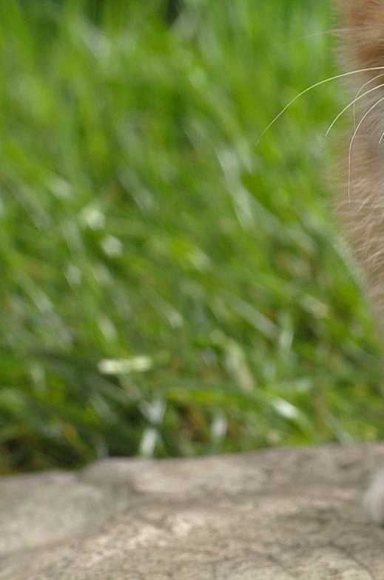
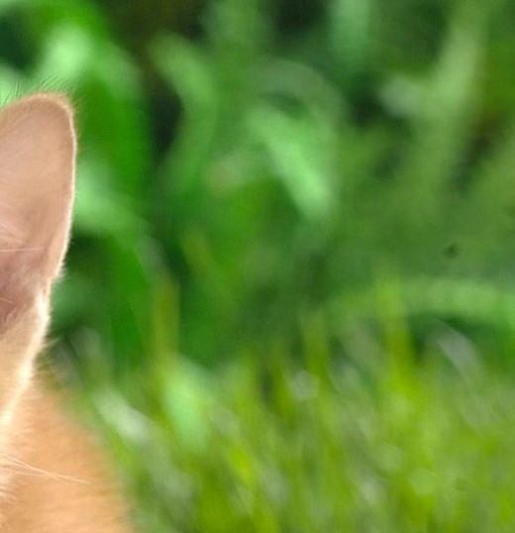
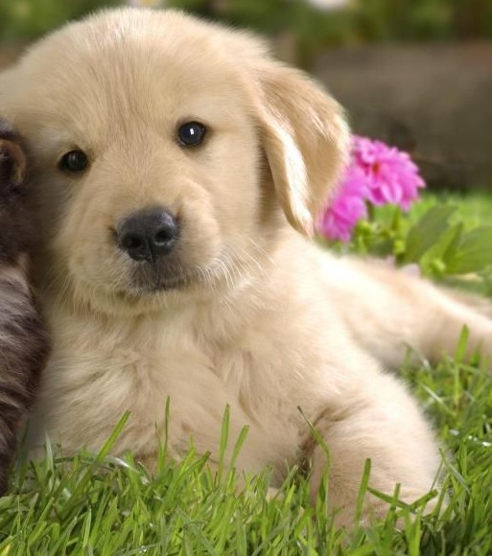


R-CNN Training
Step 4: Train one binary SVM per class to classify region features
Training image regions
Cached region features
Positive samples for cat SVM
Negative samples for cat SVM
Fei-Fei Li & Andrej Karpathy & Justin Johnson Lecture 8 - 1 Feb 2016
Lecture 8 - 57

Slide 44


R-CNN Training
Step 4: Train one binary SVM per class to classify region features
Training image regions
Cached region features
Negative samples for dog SVM
Positive samples for dog SVM
Fei-Fei Li & Andrej Karpathy & Justin Johnson Lecture 8 - 1 Feb 2016
Lecture 8 - 58

Slide 45
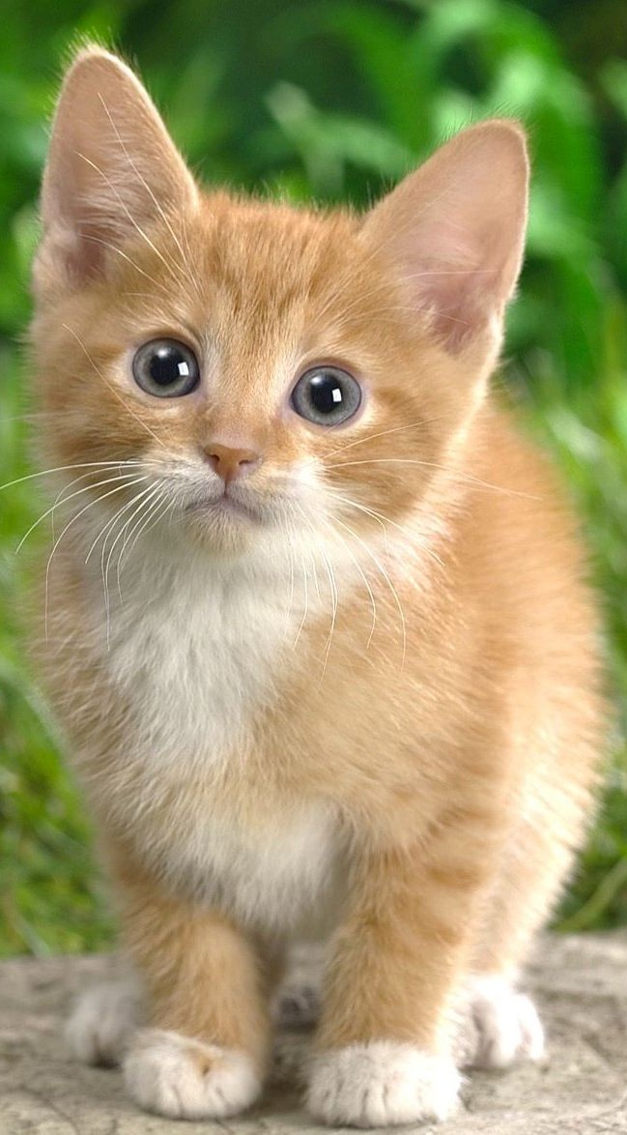

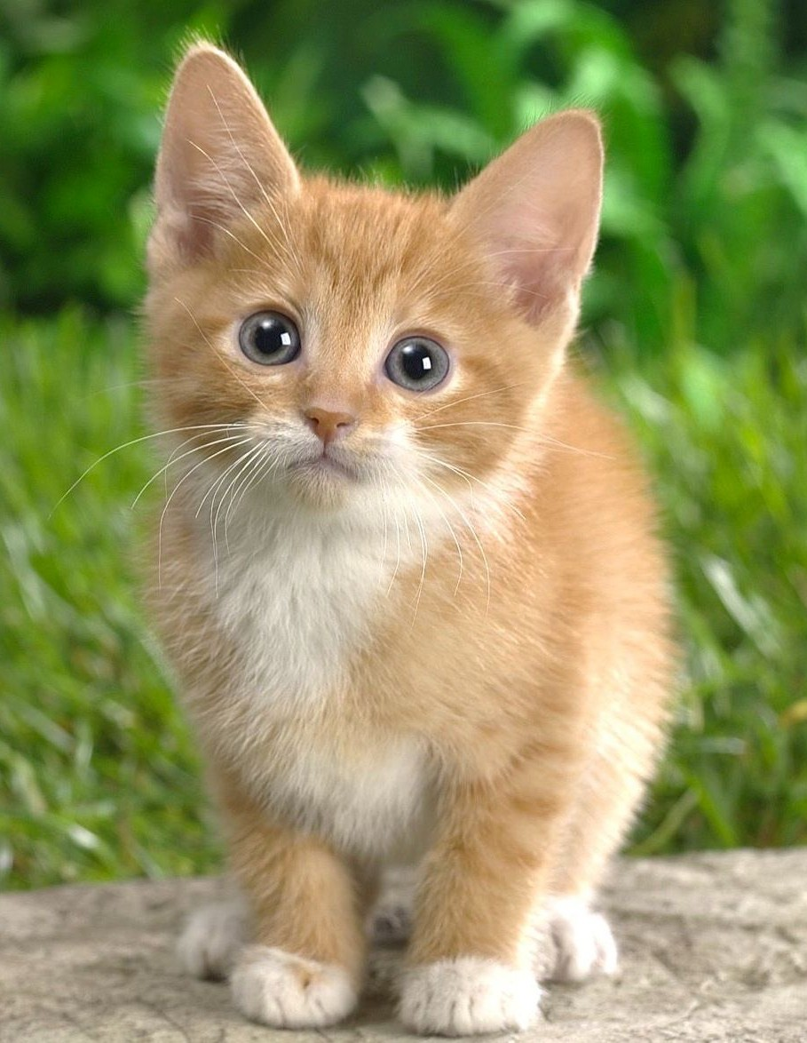
R-CNN Training
Step 5 (bbox regression): For each class, train a linear regression model to map from cached features to offsets to GT boxes to make up for “slightly wrong” proposals
Training image regions
Cached region features
Regression targets (dx, dy, dw, dh)
Normalized coordinates
(0, 0, 0, 0)
Proposal is good
(.25, 0, 0, 0)
Proposal too far to left
(0, 0, -0.125, 0)
Proposal too wide
Fei-Fei Li & Andrej Karpathy & Justin Johnson Lecture 8 - 1 Feb 2016
Lecture 8 - 59

Slide 46
Object Detection: Datasets
 | PASCAL VOC (2010) | ImageNet Detection (ILSVRC 2014) | MS-COCO (2014)
Number of classes | 20 | 200 | 80
Number of images (train + val) | ~20k | ~470k | ~120k
Mean objects per image | 2.4 | 1.1 | 7.2
Fei-Fei Li & Andrej Karpathy & Justin Johnson Lecture 8 - 1 Feb 2016
Lecture 8 - 60

Slide 47
Object Detection: Evaluation
We use a metric called “mean average precision” (mAP)
Compute average precision (AP) separately for each class, then average over classes
A detection is a true positive if it has IoU with a ground-truth box greater than some threshold (usually 0.5) (mAP@0.5)
Combine all detections from all test images to draw a precision / recall curve for each class; AP is area under the curve
TL;DR mAP is a number from 0 to 100; high is good
Fei-Fei Li & Andrej Karpathy & Justin Johnson Lecture 8 - 1 Feb 2016
Lecture 8 - 61

Slide 48
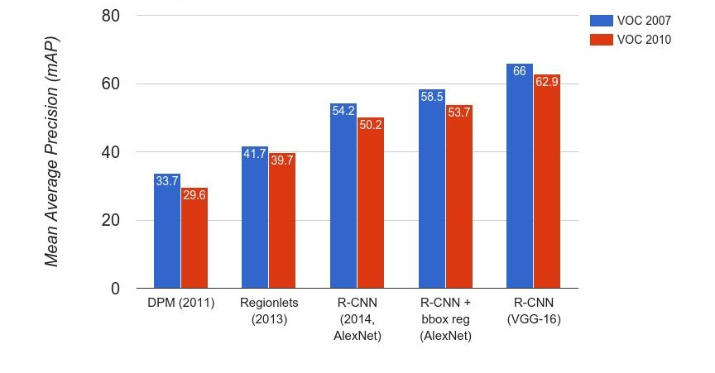
R-CNN Results
Wang et al, “Regionlets for Generic Object Detection”, ICCV 2013
Fei-Fei Li & Andrej Karpathy & Justin Johnson Lecture 8 - 1 Feb 2016
Lecture 8 - 62

Slide 49

R-CNN Results
Big improvement compared to pre-CNN methods
Fei-Fei Li & Andrej Karpathy & Justin Johnson Lecture 8 - 1 Feb 2016
Lecture 8 - 63

Slide 50

R-CNN Results
Bounding box regression helps a bit
Fei-Fei Li & Andrej Karpathy & Justin Johnson Lecture 8 - 1 Feb 2016
Lecture 8 - 64

Slide 51

R-CNN Results
Features from a deeper network help a lot
Fei-Fei Li & Andrej Karpathy & Justin Johnson Lecture 8 - 1 Feb 2016
Lecture 8 - 65

Slide 52
R-CNN Problems
Slow at test-time: need to run full forward pass of CNN for each region proposal
SVMs and regressors are post-hoc: CNN features not updated in response to SVMs and regressors
Complex multistage training pipeline
Fei-Fei Li & Andrej Karpathy & Justin Johnson Lecture 8 - 1 Feb 2016
Lecture 8 - 66

Slide 53
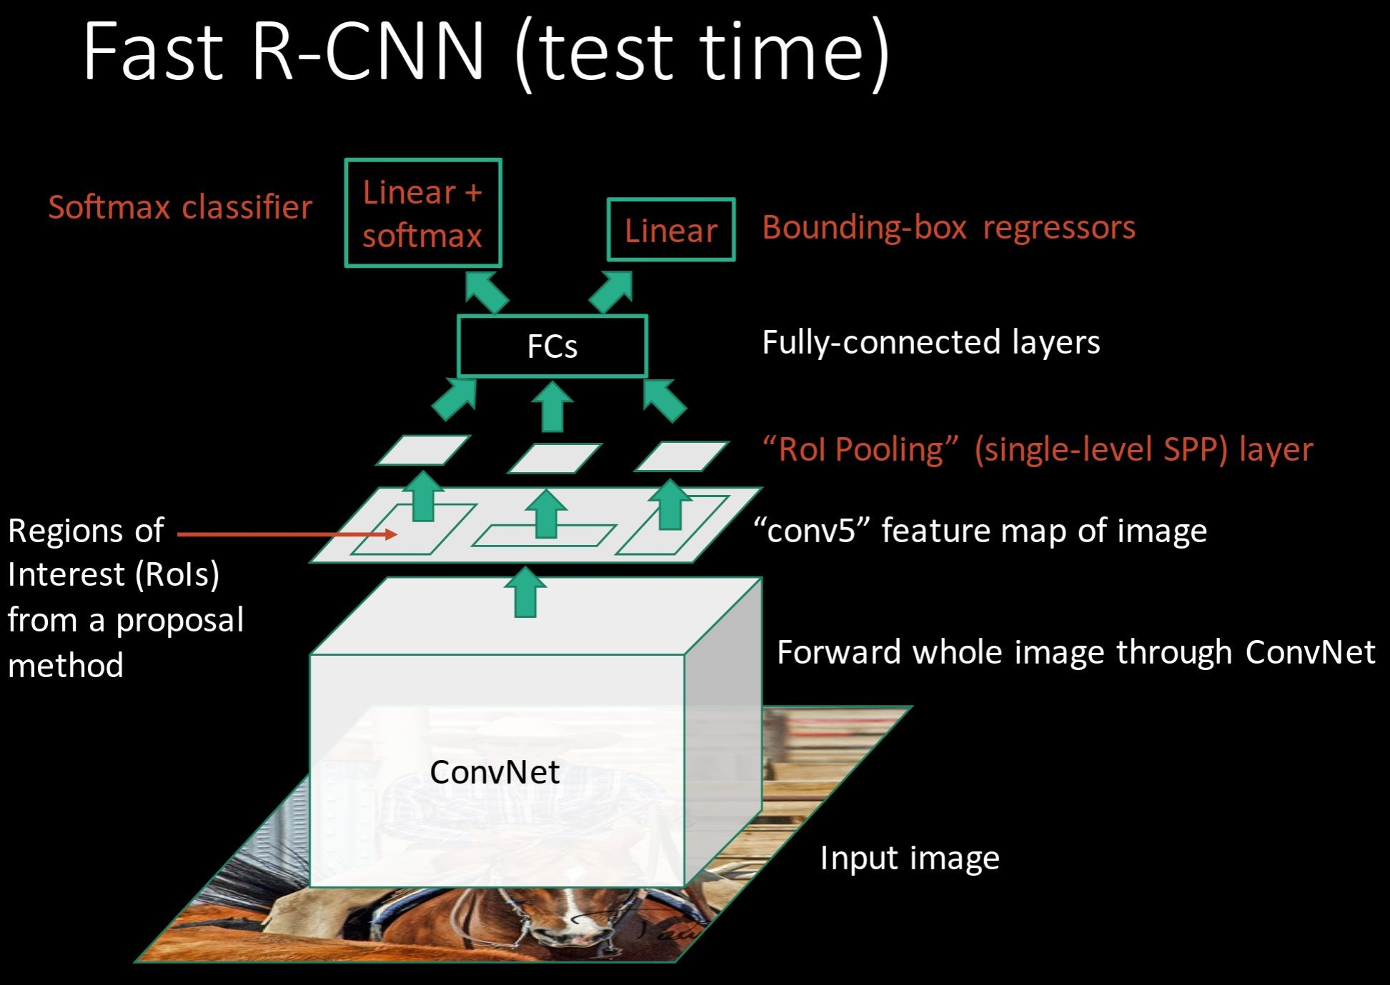
Girschick, “Fast R-CNN”, ICCV 2015
Slide credit: Ross Girschick
Fei-Fei Li & Andrej Karpathy & Justin Johnson Lecture 8 - 1 Feb 2016
Lecture 8 - 67

Slide 54

R-CNN Problem #1: Slow at test-time due to independent forward passes of the CNN
Solution:
Share computation of convolutional layers between proposals for an image
Fei-Fei Li & Andrej Karpathy & Justin Johnson Lecture 8 - 1 Feb 2016
Lecture 8 - 68

Slide 55
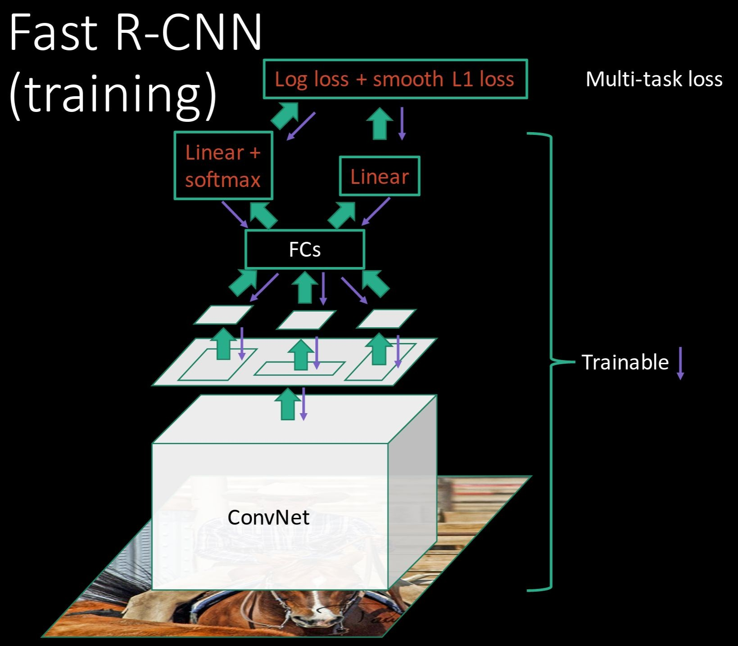
R-CNN Problem #2:
Post-hoc training: CNN not updated in response to final classifiers and regressors
R-CNN Problem #3:
Complex training pipeline
Solution:
Just train the whole system end-to-end all at once!
Slide credit: Ross Girschick
Fei-Fei Li & Andrej Karpathy & Justin Johnson Lecture 8 - 1 Feb 2016
Lecture 8 - 69

Slide 56
Fast R-CNN: Region of Interest Pooling
Convolution and Pooling
Fully-connected layers
Hi-res input image: 3 x 800 x 600
with region proposal
Hi-res conv features:
C x H x W
with region proposal
Problem: Fully-connected layers expect low-res conv features: C x h x w
Fei-Fei Li & Andrej Karpathy & Justin Johnson Lecture 8 - 1 Feb 2016
Lecture 8 - 70

Slide 57
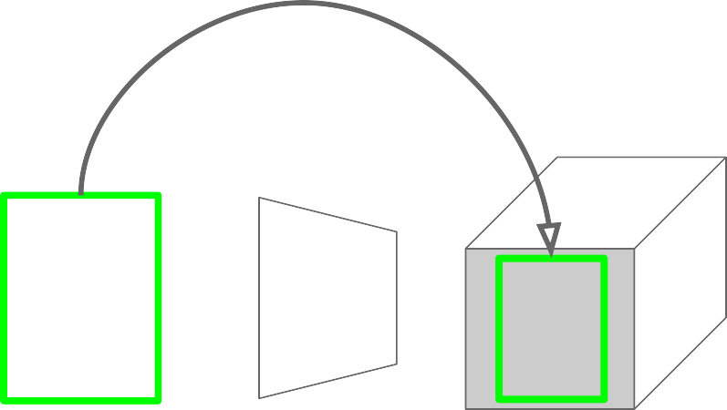
Fast R-CNN: Region of Interest Pooling
Project region proposal onto conv feature map
Convolution and Pooling
Fully-connected layers
Hi-res input image: 3 x 800 x 600
with region proposal
Hi-res conv features:
C x H x W
with region proposal
Problem: Fully-connected layers expect low-res conv features: C x h x w
Fei-Fei Li & Andrej Karpathy & Justin Johnson Lecture 8 - 1 Feb 2016
Lecture 8 - 71

Slide 58
Fast R-CNN: Region of Interest Pooling
Convolution and Pooling
Divide projected region into h x w grid
Fully-connected layers
Hi-res input image: 3 x 800 x 600
with region proposal
Hi-res conv features:
C x H x W
with region proposal
Problem: Fully-connected layers expect low-res conv features: C x h x w
Fei-Fei Li & Andrej Karpathy & Justin Johnson Lecture 8 - 1 Feb 2016
Lecture 8 - 72

Slide 59
Fast R-CNN: Region of Interest Pooling
Max-pool within
Convolution and Pooling
each grid cell
Fully-connected layers
Hi-res input image: 3 x 800 x 600
with region proposal
Hi-res conv features:
C x H x W
with region proposal
RoI conv features:
C x h x w
for region proposal
Fully-connected layers expect low-res conv features:
C x h x w
Fei-Fei Li & Andrej Karpathy & Justin Johnson Lecture 8 - 1 Feb 2016
Lecture 8 - 73

Slide 60
Fast R-CNN: Region of Interest Pooling
Can back propagate
Convolution and Pooling
similar to max pooling
Fully-connected layers
Hi-res input image: 3 x 800 x 600
with region proposal
Hi-res conv features:
C x H x W
with region proposal
RoI conv features:
C x h x w
for region proposal
Fully-connected layers expect low-res conv features:
C x h x w
Fei-Fei Li & Andrej Karpathy & Justin Johnson Lecture 8 - 1 Feb 2016
Lecture 8 - 74

Slide 61
Fast R-CNN Results
 | R-CNN | Fast R-CNN
Training Time: | 84 hours | 9.5 hours
(Speedup) | 1x | 8.8x
Faster!
Using VGG-16 CNN on Pascal VOC 2007 dataset
Fei-Fei Li & Andrej Karpathy & Justin Johnson Lecture 8 - 1 Feb 2016
Lecture 8 - 75

Slide 62
Fast R-CNN Results
 | R-CNN | Fast R-CNN
Training Time: | 84 hours | 9.5 hours
(Speedup) | 1x | 8.8x
Test time per image | 47 seconds | 0.32 seconds
(Speedup) | 1x | 146x
Faster!
FASTER!
Using VGG-16 CNN on Pascal VOC 2007 dataset
Fei-Fei Li & Andrej Karpathy & Justin Johnson Lecture 8 - 1 Feb 2016
Lecture 8 - 76

Slide 63
Fast R-CNN Results
 | R-CNN | Fast R-CNN
Training Time: | 84 hours | 9.5 hours
(Speedup) | 1x | 8.8x
Test time per image | 47 seconds | 0.32 seconds
(Speedup) | 1x | 146x
mAP (VOC 2007) | 66.0 | 66.9
Faster!
FASTER!
Better!
Using VGG-16 CNN on Pascal VOC 2007 dataset
Fei-Fei Li & Andrej Karpathy & Justin Johnson Lecture 8 - 1 Feb 2016
Lecture 8 - 77

Slide 64
Fast R-CNN Problem:
Test-time speeds don’t include region proposals
 | R-CNN | Fast R-CNN
Test time per image | 47 seconds | 0.32 seconds
(Speedup) | 1x | 146x
Test time per image with Selective Search | 50 seconds | 2 seconds
(Speedup) | 1x | 25x
Fei-Fei Li & Andrej Karpathy & Justin Johnson Lecture 8 - 1 Feb 2016
Lecture 8 - 78

Slide 65
Fast R-CNN Problem Solution:
Test-time speeds don’t include region proposals Just make the CNN do region proposals too!
 | R-CNN | Fast R-CNN
Test time per image | 47 seconds | 0.32 seconds
(Speedup) | 1x | 146x
Test time per image with Selective Search | 50 seconds | 2 seconds
(Speedup) | 1x | 25x
Fei-Fei Li & Andrej Karpathy & Justin Johnson Lecture 8 - 1 Feb 2016
Lecture 8 - 79

Slide 66
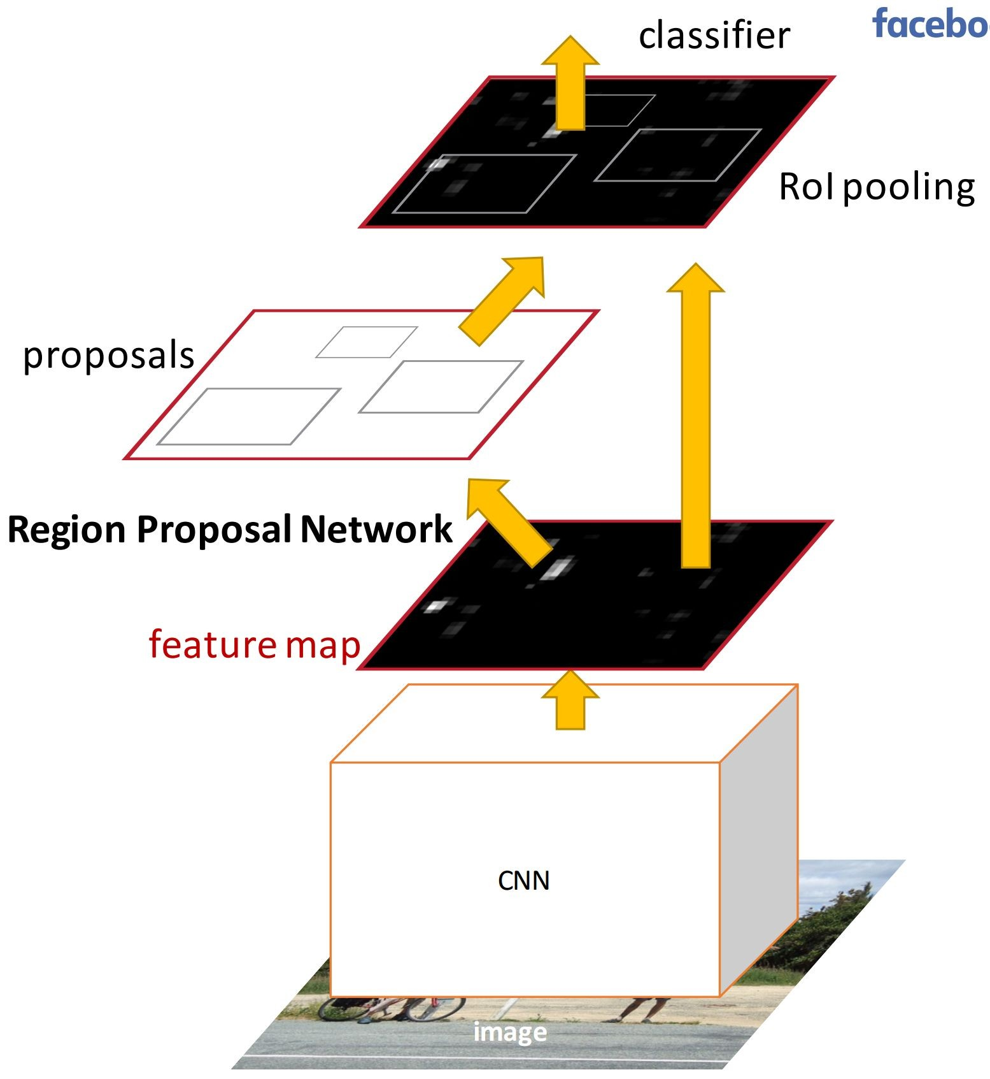
Faster R-CNN:
Insert a Region Proposal Network (RPN) after the last convolutional layer
RPN trained to produce region proposals directly; no need for external region proposals!
After RPN, use RoI Pooling and an upstream classifier and bbox regressor just like Fast R-CNN
Ren et al, “Faster R-CNN: Towards Real-Time Object Detection with Region Proposal Networks”, NIPS 2015
Slide credit: Ross Girschick
Fei-Fei Li & Andrej Karpathy & Justin Johnson Lecture 8 - 1 Feb 2016
Lecture 8 - 80

Slide 67
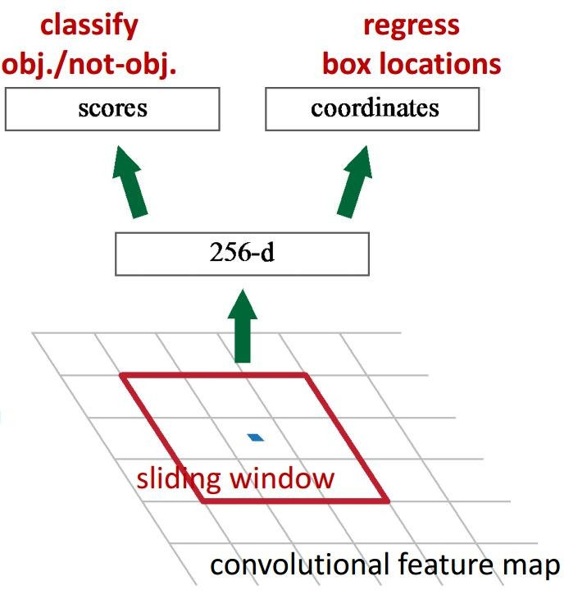
Faster R-CNN: Region Proposal Network
Slide a small window on the feature map
Build a small network for:
classifying object or not-object, and
regressing bbox locations
1 x 1 conv
1 x 1 conv
1 x 1 conv
Position of the sliding window provides localization information with reference to the image
Box regression provides finer localization information with reference to this sliding window
Slide credit: Kaiming He
Fei-Fei Li & Andrej Karpathy & Justin Johnson Lecture 8 - 1 Feb 2016
Lecture 8 - 81

Slide 68
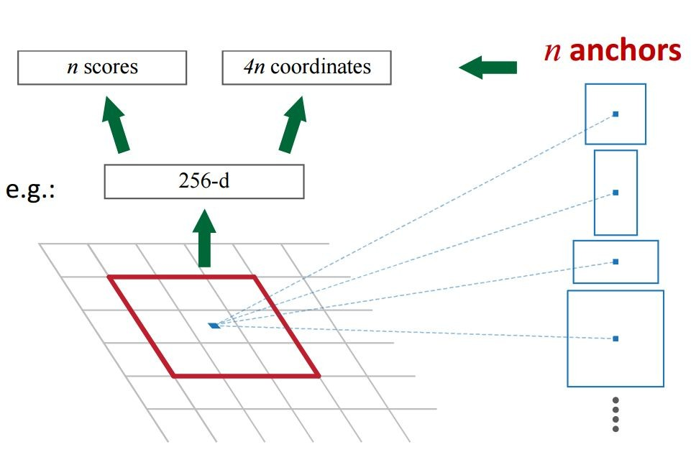
Faster R-CNN: Region Proposal Network
Use N anchor boxes at each location
Anchors are translation invariant: use the same ones at every location
Regression gives offsets from anchor boxes
Classification gives the probability that each (regressed) anchor shows an object
Fei-Fei Li & Andrej Karpathy & Justin Johnson Lecture 8 - 1 Feb 2016
Lecture 8 - 82

Slide 69
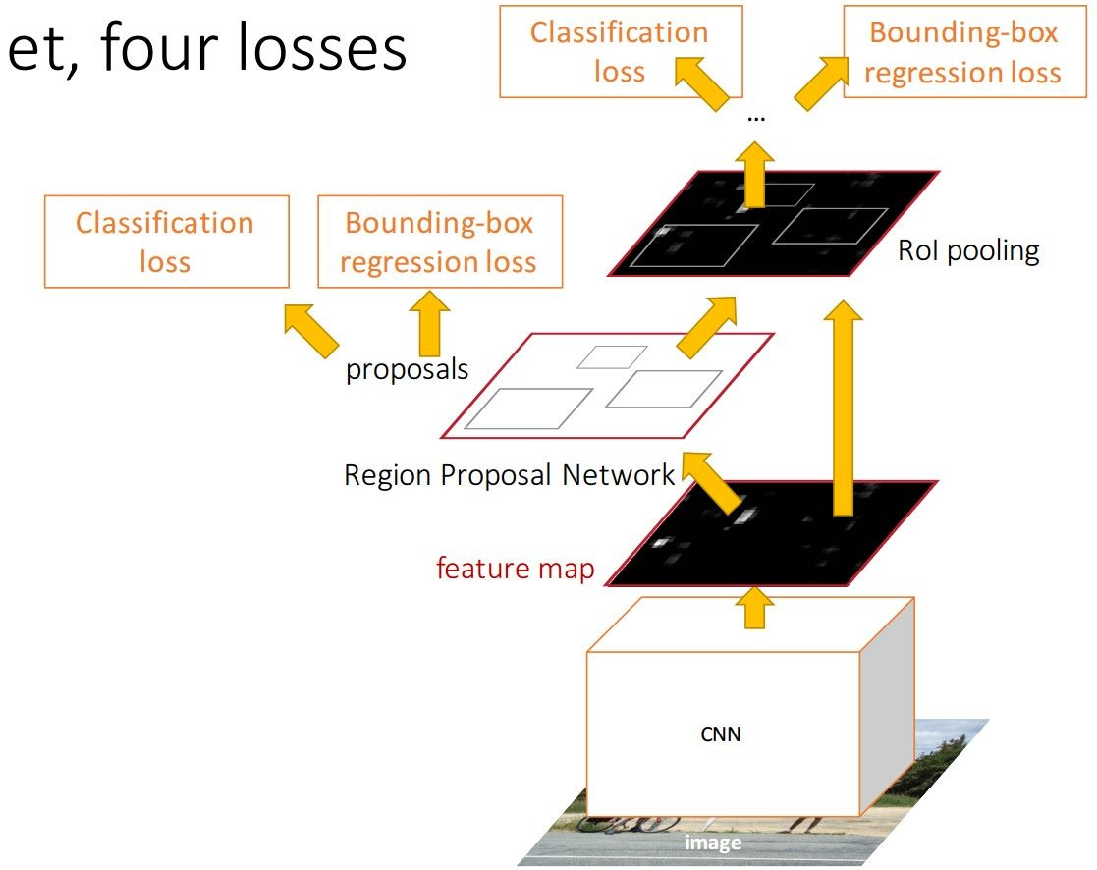
Faster R-CNN: Training
In the paper: Ugly pipeline
Use alternating optimization to train RPN, then Fast R-CNN with RPN proposals, etc.
More complex than it has to be
Since publication: Joint training! One network, four losses
RPN classification (anchor good / bad)
RPN regression (anchor -> proposal)
Fast R-CNN classification (over classes)
Fast R-CNN regression (proposal -> box)
Slide credit: Ross Girschick
Fei-Fei Li & Andrej Karpathy & Justin Johnson Lecture 8 - 1 Feb 2016
Lecture 8 - 83

Slide 70
Faster R-CNN: Results
 | R-CNN | Fast R-CNN | Faster R-CNN
Test time per image (with proposals) | 50 seconds | 2 seconds | 0.2 seconds
(Speedup) | 1x | 25x | 250x
mAP (VOC 2007) | 66.0 | 66.9 | 66.9
Fei-Fei Li & Andrej Karpathy & Justin Johnson Lecture 8 - 1 Feb 2016
Lecture 8 - 84

Slide 71
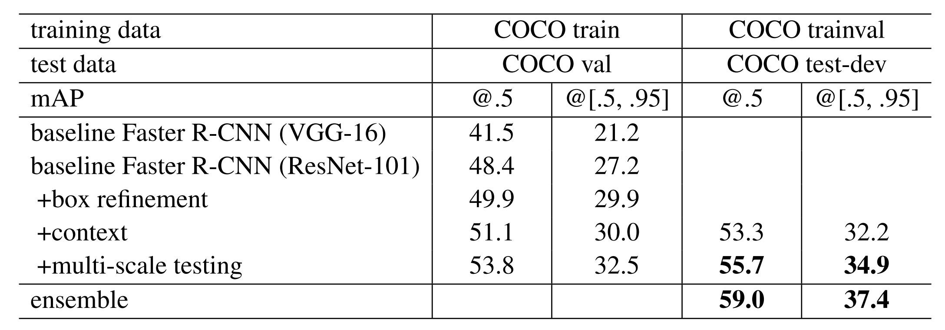
Object Detection State-of-the-art:
ResNet 101 + Faster R-CNN + some extras
He et. al, “Deep Residual Learning for Image Recognition”, arXiv 2015
Fei-Fei Li & Andrej Karpathy & Justin Johnson Lecture 8 - 1 Feb 2016
Lecture 8 - 85

Slide 72
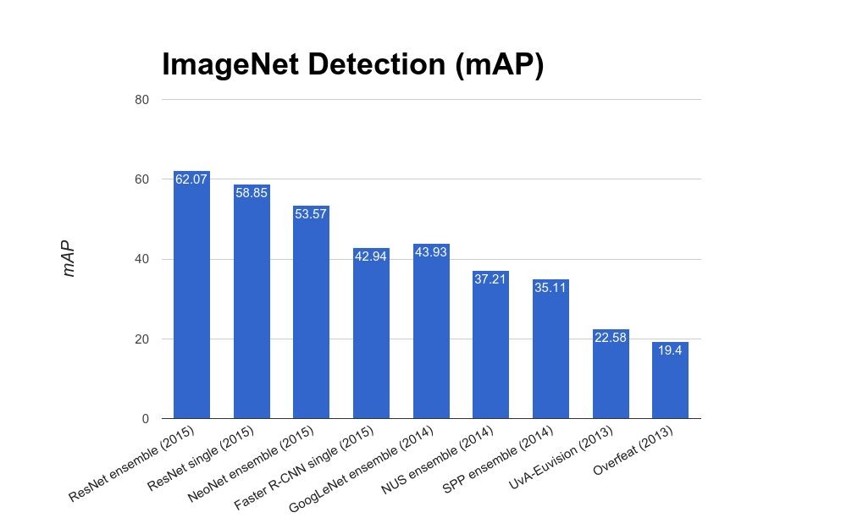
ImageNet Detection 2013 - 2015
Fei-Fei Li & Andrej Karpathy & Justin Johnson Lecture 8 - 1 Feb 2016
Lecture 8 - 86

